Slide 1
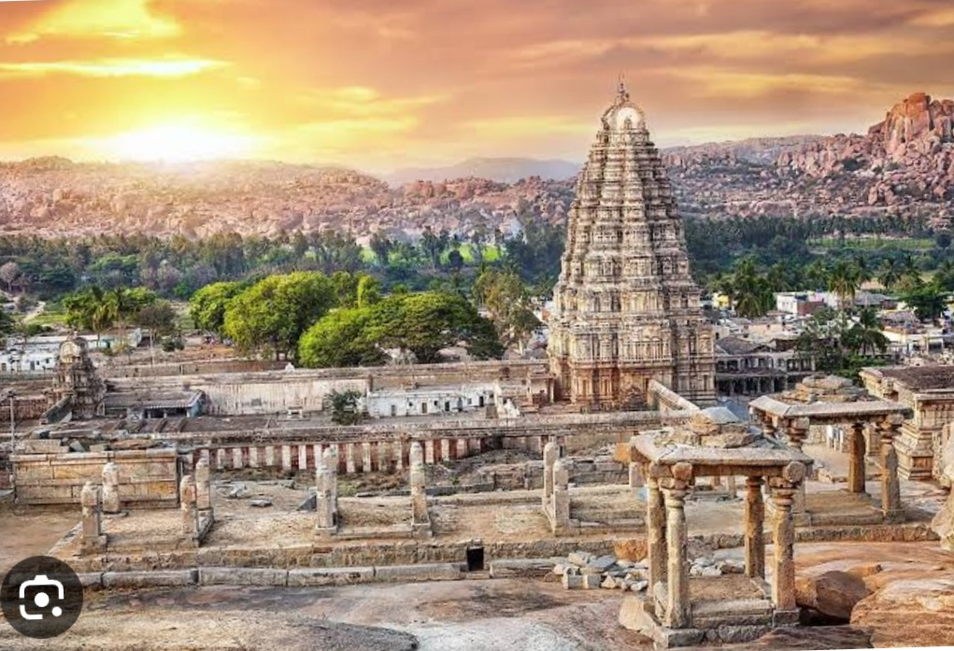

Ancient Indian History

Slide 2
Meaning of the term Ancient
Ancient means which is very old.
Which is happened before the arrival of muslims in Indian context .
In Indian History the time period from Harrapan civilization to Rajput period is known as Ancient India.

Slide 3
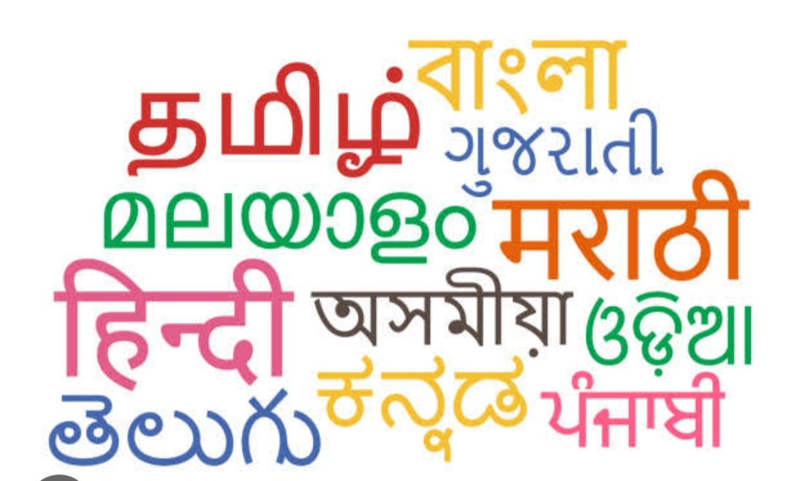
Importance of Ancient Indian History
Origin and development of Material culture .
Knowledge of various Races and casts .
Origin of languages and scripts .
Birth and growth of Indian Religions.
Unique Ancient Indian Literature.
Development of Various Arts.
Peculiar social Institutions

Slide 4
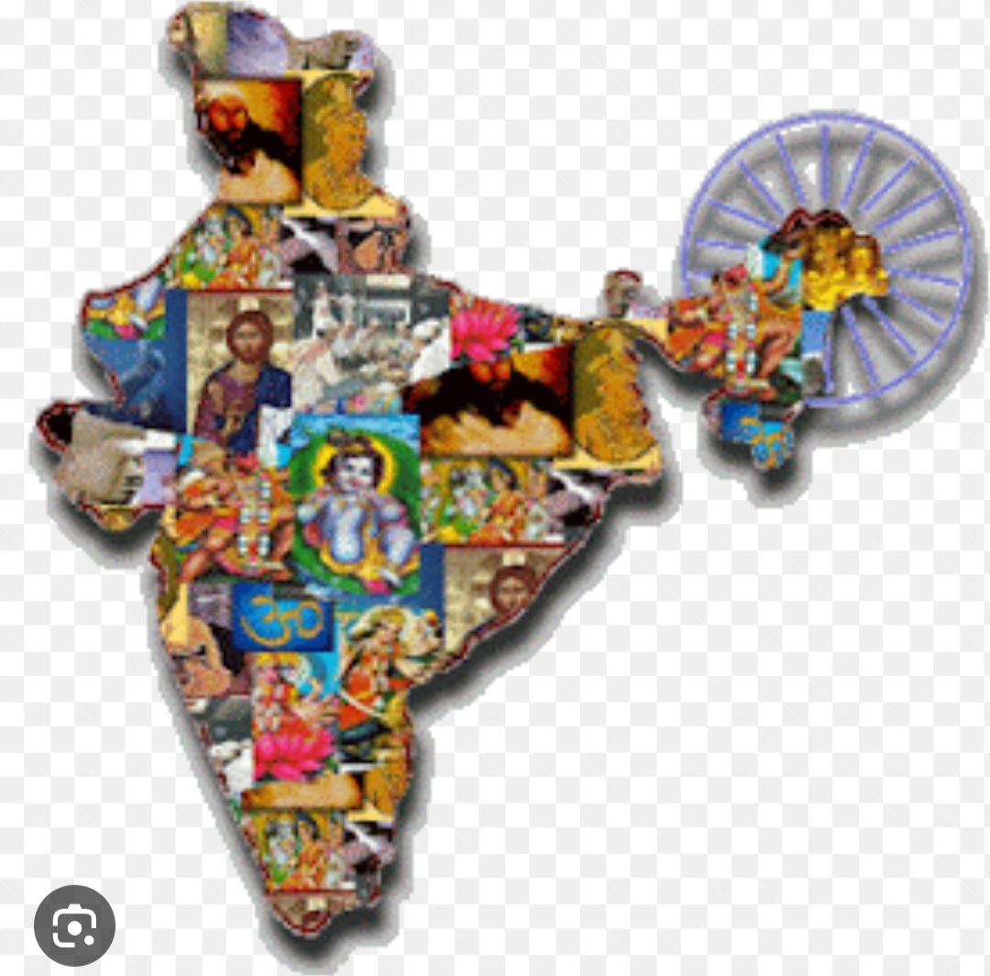
Importance of Ancient Indian History
Development of Industries and Trade.
Unlimited wealth of the country.
Democratic Institutions.
Unity in Diversity
Geographical unity
Political unity
Unity of language

Slide 5
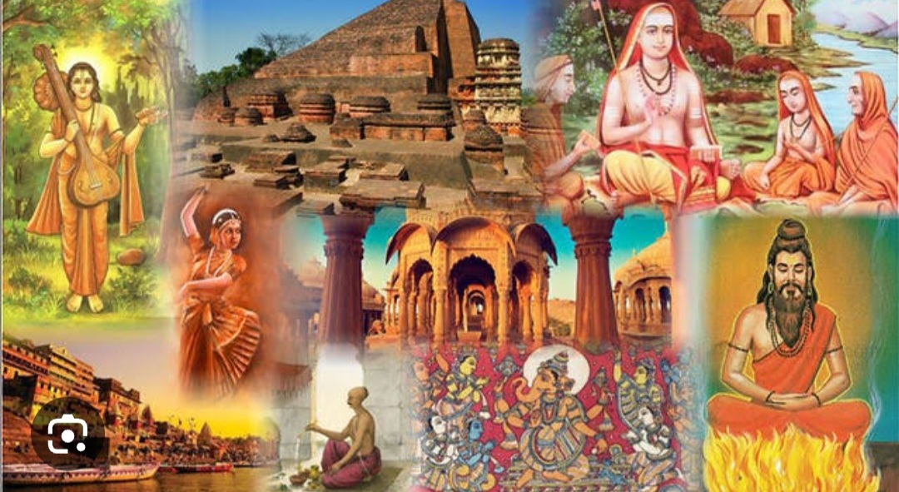
Importance of Ancient Indian History
Spread of Indian culture in Abroad.
Help in the Understanding of present day in India.
For Bright future of India.

Slide 6
Thanks you so much

